Slide 1

Module 4 –Spark Streaming

Slide 2

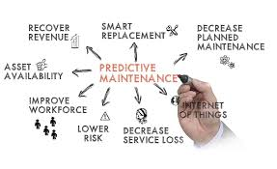
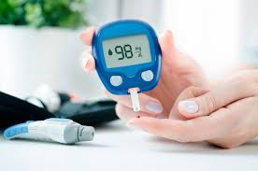




Use Cases for Real Time Streaming
SPARK STREAMING

Slide 3

What is Streamed Data?
SPARK STREAMING
Data that is produced from multiple sources continuously.
Examples:
Social Media Feeds
Sensors
Cameras
Ecommerce purchases
Log files
Server Activity
Geo location

Slide 4
Is there a difference- Streaming Analytics?
SPARK STREAMING
Traditionally
Captured
Stored
Pushed out
Streaming Analytics- Gain Insights as the data is fed in
Organizations now are more
Agile
Responsive
Proactive

Slide 5
Slightly understood
SPARK STREAMING
Data At Rest | Data at Motion
Static Data Analysis After data is collected | Analyzed at the same time as generated
Batch Processing | Stream Processing
Size determines time and space | Unbounded size but finite time and space
Whole data | Compute one data element or a small window of data elements at a time
May not be real time | Relatively fast and simple computations
Feedback | Management and process do not interact with data sources
These differences surely gives a message

Slide 6
Challenges in performing Stream Processing
SPARK STREAMING
Avoid Data loss and enable real time analytics
Driven by Human Behavior
Periodic
Sporadic
No Data
Size
Frequency
Significant Change

Slide 7
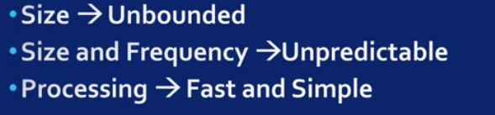
Challenges in performing Stream Processing
SPARK STREAMING
Algorithms must be relatively Fast

Slide 8
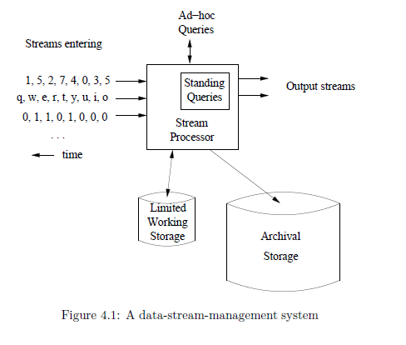
Stream Processing System
SPARK STREAMING
Multiple streams
Different rates, not synchronized
Archival store
Offline analysis, not real-time
Working store
Disk or memory
Summaries
Parts of streams
Queries
Standing queries
Ad-hoc queries

Slide 9
SPARK STREAMING
Examples of Stream Queries
Standing queries: produce outputs at appropriate time
Query is continuously running
Constantly reading new data
Query execution can be optimized
Example: maximum temperature ever recorded
Ad hoc query: not predetermined, arbitrary query
Need to store stream
Approach: store sliding window in SQL DB
Do SQL query
Example: number of unique users over last 30 days
Store logins for last 30 days

Slide 10
Consider the queries on the right. Which among them are STANDING QUERIES and which are AD HOC?
SPARK STREAMING
Exercise 1
Alert when temperature > threshold
Display average of last n temperature readings; n arbitrary
List of countries from which visits have been received over last year
Alert if website receives visit from a black-listed country

Slide 11
SPARK STREAMING
Exercise 1 Solution
Solution
Alert when temperature > threshold - standing
Display average of last n temperature readings – ad hoc
List of countries from which visits have been received over last year – ad hoc
Alert if website receives visit from a black-listed country - standing
Consider the queries on the right. Which among them are STANDING QUERIES and which are AD HOC?

Slide 12
STREAM PROCESSING
Issues in Stream Processing
Velocity
Streams can have high data rate
Need to process very fast
Volume
Low data rate, but large number of streams
Ocean sensors, pollution sensors
Need to store in memory
May not have huge memory
Approximate solutions

Slide 13
SPARK STREAMING
Need for a framework …
… for building such complex stream processing applications
But what are the requirements
from such a framework?

Slide 14
SPARK STREAMING
Requirements
Scalable to large clusters
Second-scale latencies
Simple programming model

Slide 15
THANK YOU

